Slide 1

Formula 1 history through data
February 2022

Slide 2

Formula 1 – Selected topic
The selected topic for our project is "Formula 1 history through data analysis", the purpose of this project is to show the relevance of data analysis through this sport, provide a better understanding of the sport to existing fans and provide an introduction through hard data to new fans.
Formula 1 has raised a lot of debate about the importance of the cars, the skill of the drivers as well as the teams´ performance, from the very beginning of the sport.
F1 is a racing competition that has an incredible history through all these years, being the 50’s when all this started. The F1 has a lot of data and statistics that are used to get more information about how to improve the performance in every race.

Slide 3
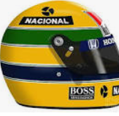
Formula 1 – selected topic
With every single competition or race performed, hard data from the event is provided just like racing times, number of laps, pit stops, drivers’ final positions, etc. that can help analyze more intangible characteristics, just like skill, teams´ preparation or drivers’ resilience through data analysis.
The data for analysis is available and verifiable, also, the data is diverse (times, stop counts, accidents, mechanical failures, etc.) so is perfect to demonstrate and place in practice the importance of data analysis for understanding sports, businesses, history and almost every topic that can be measured.
In this project, we are interested in identifying and determining the main factors that have an effect in a race and its impact in the outcome.
Formula 1 races have two fundamental elements that constantly interact, the drivers and the cars.

Slide 4
DATABASE

Slide 5
Database Source
A research was made for information that can be usable for these purposes, the characteristics of the data that could be used for the purposes of our project are the following:
Should be accurate.
Should be verifiable.
Should be diverse enough to perform our analysis.

Slide 6
Database - accuracy
Through the research of readily an accurate data the project team identified a compile that is useful for this purpose.
The project team inspected randomly some of the data to verify its accuracy through researching on motorsport websites and news to compare the data to the events reported on specialized media.
The project team concluded that the data is accurate and can be used for the purpose of this project.

Slide 7
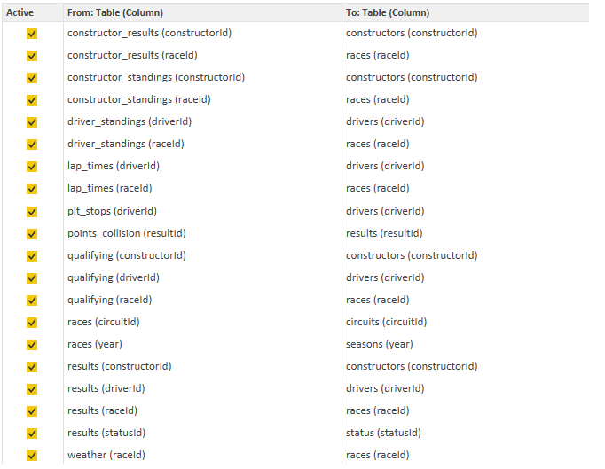
Database - diversity
An important aspect of the data sources was the diversity of the available data, on the compile can be identified diverse datasets that are useful for the project

Slide 8
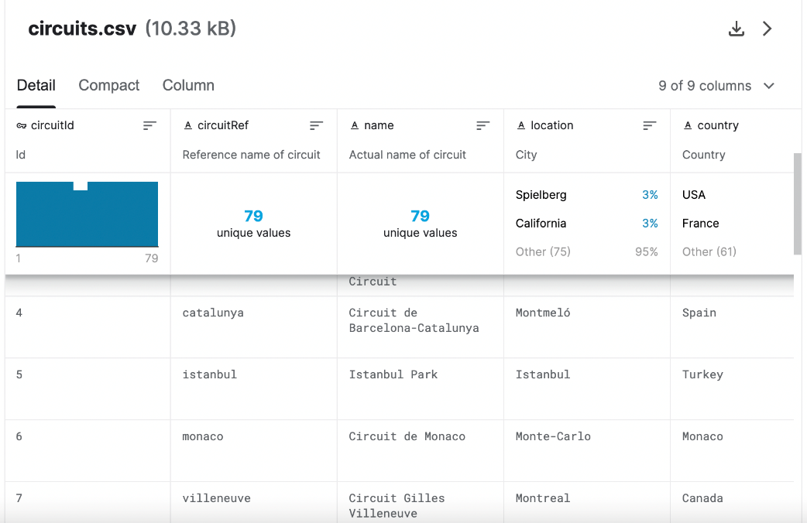
Table 1.- circuits
The information included in this dataset is circuit reference, name, location, country, lat & long, altitude.
The data provided in this data set is a description and location of the places where the races have occurred from 1950 to 2021.

Slide 9
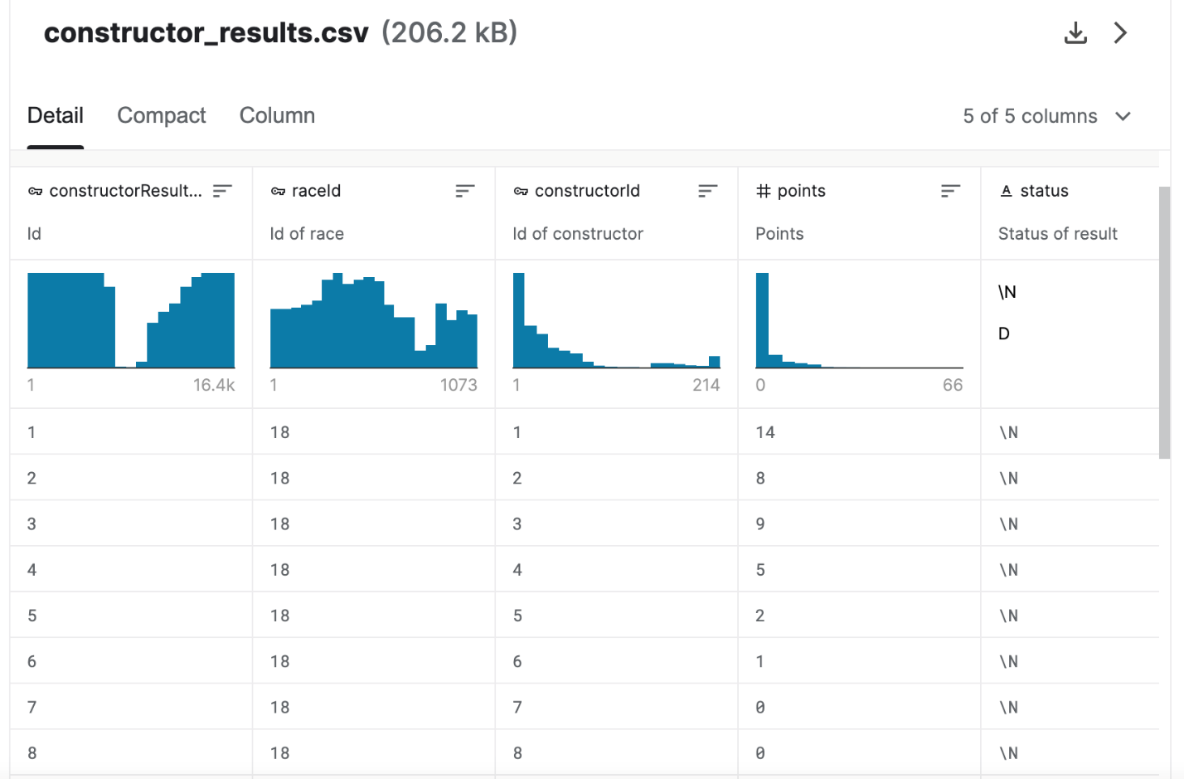
Table 2.– Constructor results
The data set includes the Raceid, constructor id, points, status.
This dataset includes a list of teams of car manufacturers and an identifier number from 1950 to 2021, also displays the number of points earned per race. In this dataset we can identify for the first time the raceid, which assigns an identifier and unique number to every single race taken from 1950 to 2021.

Slide 10
Table 3.- Constructor standings
This dataset includes the following data: Raceid, constructor id, points, position, positionText, wins.
The information presented in this dataset details the results of the constructors per race id.
Every constructor has two cars per race, however this data is presented per constructor and not per car.

Slide 11
Table 4.- Constructors
This dataset includes the following information: Constructor id, constructor ref, name, nationality.
This is basic information of the constructor team and it’s assigned identifier number.

Slide 12
Table 5.- Driver standings
This data set includes the following information: Raceid, driverid, points, position, positionText, wins.
What this dataset represents is the outcome of every single pilot through all races run from 1950 to 2021, meaning as outcome the position achieved at the end of the race and points earned during the session.

Slide 13
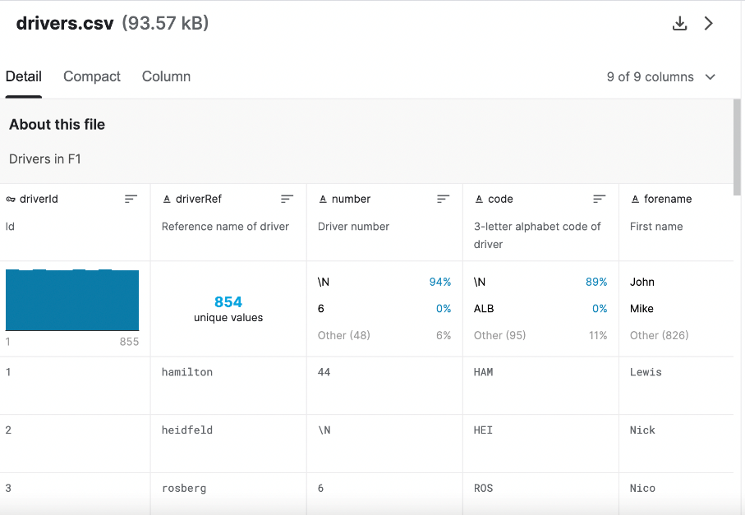
Table 6.- Drivers
This dataset includes the following information: Driverid, driver ref, number, code, forename, surname, dob, nationality.
This dataset displays basic information about every pilot that has raced in Formula 1 from 1950 to 2021, it assigns as well as a unique identifier number so it can be used in other datasets.

Slide 14
Table 7.- Lap Times
The dataset includes the following information: Raceid, driverid, lap, postion, time, milliseconds.
This dataset includes the time taken for every single driver to drive a lap in every course for every race from 1950 to 2021.

Slide 15
Table 8.- Pit stops
The dataset includes the following information: Raceid, driverid, stop, lap, time, duration, milliseconds.
As a reference, a pit stop is a “break” taken during the race to change tires, fuel the car or repair any problem with the car, every single race usually requires at least one pit stop per driver.
The dataset provides a list of the pit stops taken by driver for every single race and the duration (in time) that each pit stop took.

Slide 16
Table 9.- Qualifying
The dataset includes the following information: Qualifyid, raceid, driverid, constructorid, number, position, q1, q2, q3.
As a reference, the position from where a pilot will start a race is determined by the previous qualification, for most of the cases the qualification consist in driving the course where the race will be taken place, the pilot that takes the least time In completing a lap is the pilot who will start in first place and so on, there are some other qualification models for a few races where a brief race with less laps is considered for qualification, the position where the pilots finish this race, will be the position where the pilots will start in the main race.
The dataset assigns an identifier for the qualification event, the race that is corresponds, the drivers that participated in the qualification, as well as the outcome.

Slide 17
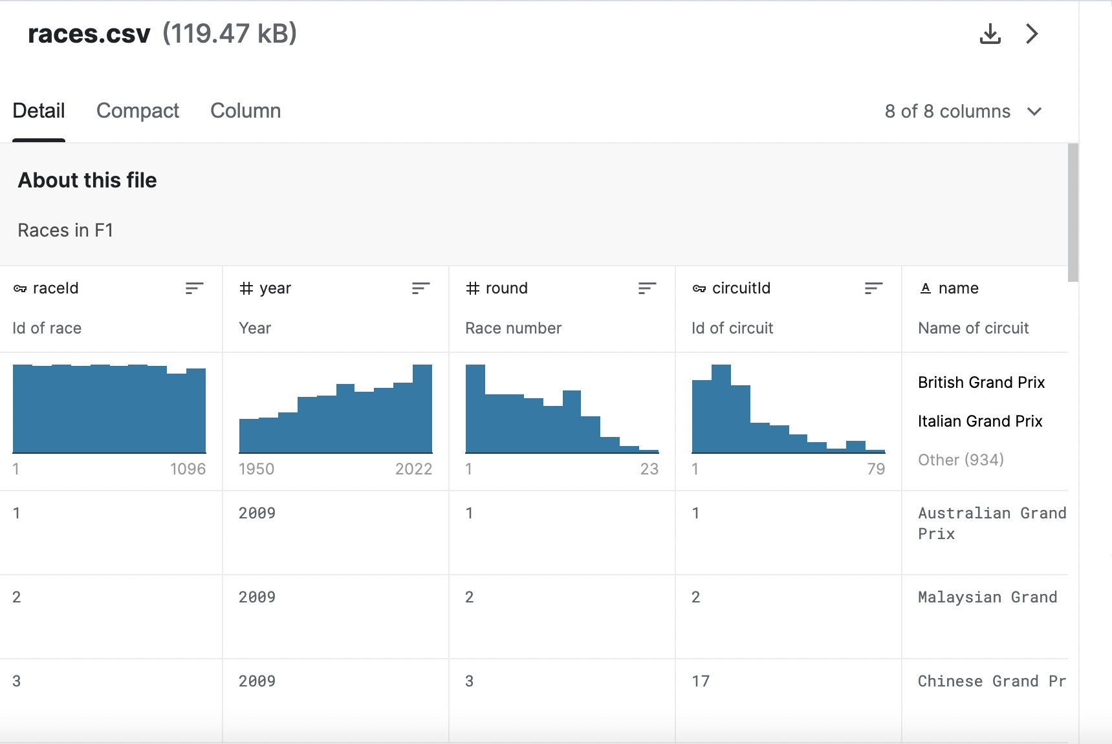
Table 10.- Races
The dataset includes the following information: Raceid, year, round, circuitid, name, date, time.
This dataset includes basic information about every race taken place from 1950 to 2021 and assigns a unique identifier number.

Slide 18
Table 11.- Results
The dataset includes the following information: Resultid, raceid, driverid, constructorid, number, grid, position, positionText, points, laps, time, rank, statusid.
This dataset consolidates many of the date detailed in the datasets described above and provides information about a general outcome of every race and the results of every pilot.

Slide 19
Table 12.- Seasons
The dataset includes the following information: Years
This dataset describes the year of the season to identify when the races took place.

Slide 20
Table13.- Status
The dataset includes the following information: Statusid, status.
This dataset describes and assigns an identifier number to the status of the driver at the end of the race, example: if the pilot finished the race, if he had an accident, an engine malfunction, crashing incidents, etc.

Slide 21
Questions to be answered

Slide 22
Questions to be answered
How relevant is the driver vs the car to determine a championship output?
How relevant is the pit stop average time to a championship output?
Which are the most relevant mechanical failures to determine a constructor, championship output?
How relevant is the number of pole positions to the championship output?
Which factor is the determinant to get a F1 winner?
Factors like time in the pits, type of tracks, crucial faults, qualifying times affect the result?
The objective of the project is to display all the relevant data generated from this sport to obtain and understanding of the sport through data analysis for fans and new enthusiasts of the sport.
Build a narrative of how the results and outcomes per race are built through data analysis and use this information and understanding to predict the outcome of the incoming races and consequently the season winner.
Some of the questions we have initially designed with the available datasets are the following:

Slide 23
Questions to be answered
For us to get to the answer we are going to analyze the data regarding some important racing factors.
Pits times
Qualification
Wins per constructor
Wins per pilot
Lap times
Circuits characteristics
Race results

Slide 24
Database integration

Slide 25
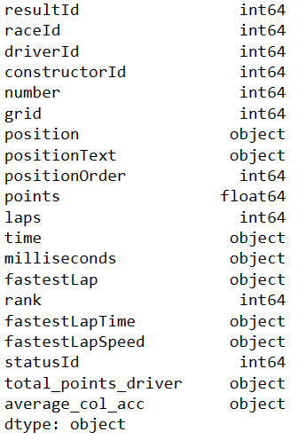
Database integration
Once that the project team has obtained a useful data source, the next step will be analyzing the data and integrate all the useful information to calculate new relevant variables for the project.
The dataset was pushed into SQL from S3 storage in AWS, so the team inspected datatypes in google colab, looked for null data or any other anomaly on the datasets that would need to be cleaned.
Once cleaned, the data was written to the AWS RDS database with the help of postgres, the schema was previously created with PG Admin4.
The datatypes for the relevant inputs are the following:

Slide 26
Database integration
To start the database integration, we followed the following steps:
Create an S3 bucket in AWS repository and save the CSV files (15) that will be used in the project.
Read the CSV files with PySpark in google colab and clean datatypes for all the dataframes.
Create a RDS instance in AWS to store the database
Use PG Admin 4 to create the schema of the database in AWS RDS
Use Pyspark and Postgress to write the dataframes into the database’s tables previously created.
Use SQL in PG Admin to filter and then merge results and status tables to create a main table that will be used to start the complete analysis.

Slide 27
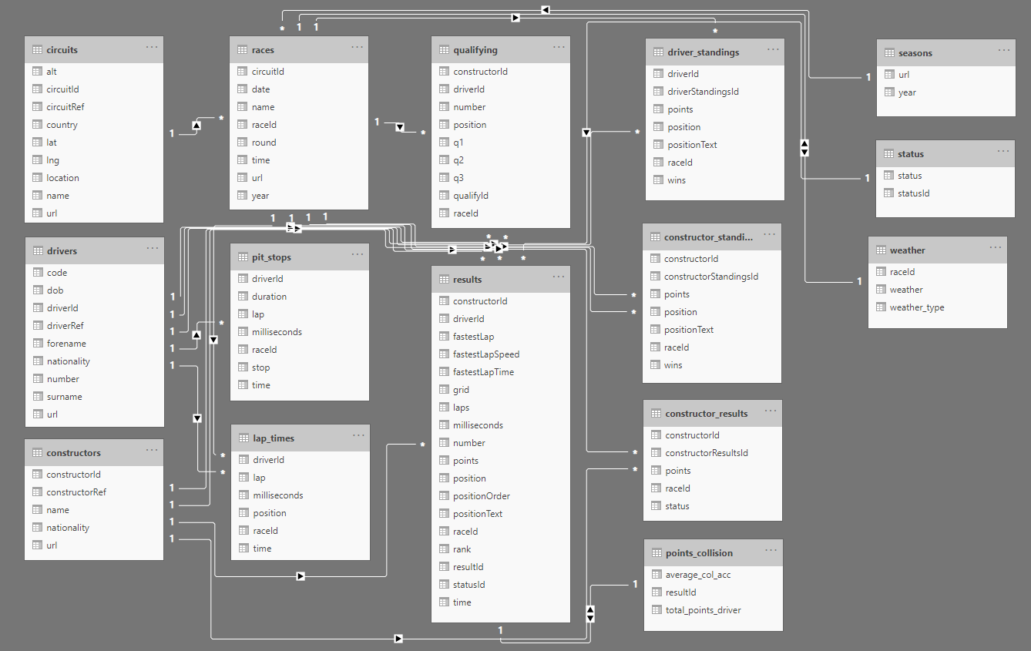
Database integration
This is the visual schema and the relationships all table have:

Slide 28
Visual presentation and dashboards

Slide 29

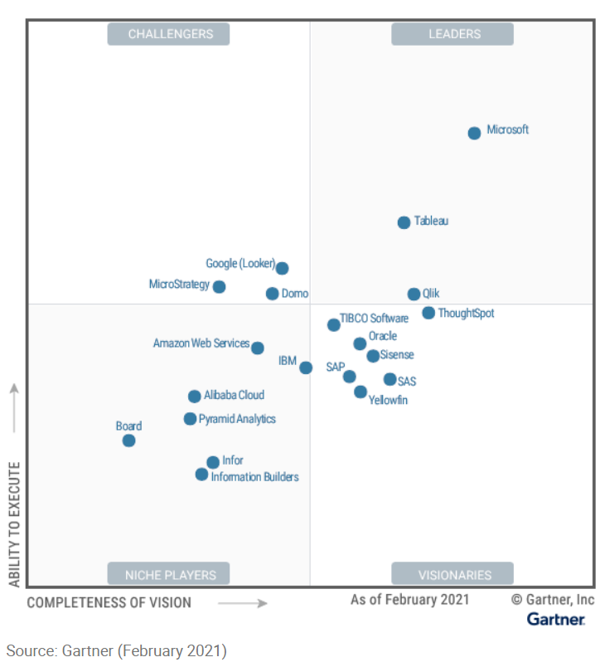
Tableau
Tableau is a visual analytics platform transforming the way we use data to solve problems—empowering people and organizations to make the most of their data
Tableau is acknowledged as one of the leaders in industry to cover BI&A (Business Intelligence and Analytics) just behind Power BI as per Gartner 2021 magic quadrants for BI&A

Slide 30
Visual presentation and dashboards
Worksheet | Visual representation
Course locations | Map visual representation
Historical constructor points | Bar plot
Constructor nationality | Pie plot
Season winners | Bar plot
Race winners (pilots) | Bar plot
Season constructor winners | Pie plot
Racer’s nationality | Pie plot
Pit stop/outcome correlation | Scatter plot
Total constructor points/outcome correlation | Scatter plot
Total season points/outcome correlation | Scatter plot
Fastest laps/outcome correlation | Scatter plot
Pilot experience years/outcome correlation | Scatter plot
Starting position/outcome correlation | Scatter plot
Pilot experience on the course/outcome correlation | Scatter plot
Accident or crash average/outcome correlation | Scatter plot
Pilot total points/outcome correlation | Scatter plot
Season constructor earned points/outcome correlation | Scatter plot
Average malfunctions/outcome correlation | Scatter plot
Historical malfunctions per course/outcome correlation | Scatter plot
The results and graphic representation of the project will be displayed in Tableau.
The objective of the project is to give an appropriate context of the sport through data before trying to predict the outcome of future races, so we will create and plot worksheets with relevant information to give the user a complete story and relevant data of the sport.
The worksheets and the visual representation that will be used are as follows:
The final dashboard will include a combination of this worksheets visual representation.

Slide 31
Machine learning models

Slide 32
Machine learning models
Correlation analysis
First of all, as we are interested on identify the linear relationship between some variables and compute their association, we must set up a correlation analysis also this will help us to identify the potential variables of interest, high correlation points to a strong relationship between the two variables. The result will show us the direction of the relationship (positive or negative correlation) or if not exist correlation.
Principal Component Analysis
We will use this statistical technique to group similar variables reducing the number of dimensions by transforming a large set of variables into a smaller one that contains most of the information. Using this technique will depend in the number of variables that could be correlated.

Slide 33
Machine learning models
Linear and multiple linear regression
We will use linear regression and multiple linear models as an exploratory tool to quantify and measure the variability of two or more correlated variables, in fact linear regression is an extension of the correlation analysis. Linear regression could help us to know if values from some variables let us predict values for our dependent variable. Using a multiple linear regression, we can try with multiple independent variables to account for parts of the total variance observed in the dependent variable.
We will use the significancy for each independent variable to determine if there is a significant relationship with the dependent variable. Once we have evaluated each independent variable, we'll evaluate the r-squared value of the model to determine if the model sufficiently predicts our dependent variable.

Slide 34
Machine learning models
Supervised Learning
We believe we can use some supervised model to deal with our research question, as we know who the winner for every race was. Machine learning models let us predict, based on data from previous patients who driver could win based on some features
Logistic regression predicts binary outcomes and evaluates the probability of an occurrence, so we can calculate the percentage of possibility for one drive who own to one constructor to win a race using multiple variables as qualify position, time on pit stops, drivers experience and also tracks. The model would take features into account and decide whether a driver can or not win meaning that there are only two possible outcomes.
Like logistic regression, Support vector machine (SVM) is another supervised learning model that we can use to classify if a sample is categorized into one of two possibilities (win or lose). Finally applying a Random forest algorithm, we can rank the importance of input variables in order to remove some variables that could be affecting the model.
Depending in our final dataset, if It has many data points or complex features, may overwhelm the previous models, in that case we could attempt to use a deep learning model as neural networks to evaluate every interaction within and across neurons.
Unsupervised Learning
At this moment, we cannot rule out the use of an unsupervised learning model, even when we know the previous result on our database. We can use this type of model to find hidden patterns.

Slide 35
Technologies Used

Slide 36

Technologies used
Data Cleaning and Analysis
Python pyspark and pandas will be used to clean the data and perform an exploratory analysis. As a query technology we will use SQL in PG Admin4 to merge and query the complete data prior to start our analysis.
Database Storage
AWS RDS, AWS S3, Python Pyspark and postgres will be the tools we will use to store and read our data from SQL cloud service, we will use python to read the information out from SQL source and will start the analysis from there.

Slide 37

Technologies used
Machine Learning
For Correlation analysis we will use R geom_point() plotting function combined with the cor() function to quantify the correlation between variables. Also, we will use the lm() function in R or the sklearn for linear regression module in python to calculate the multiple linear regression model. The idea is to apply linear regression to define the level of relationship between variables
For Machine Learning we are planning to use sklearn (LogisticRegression, SVC and RandomForestClassifier) module and hvplot for ploting mainly. Also, if it is necessary, we will use tensorflow to run a neural network model
Other statistical techniques as PCA will help us to create clusters and with that define if either the constructor or the pilot has more leverage on winning a race.
Dashboard
In order to create visual graphs and the story telling about our analysis, we will use Tableau and python as the visualization tool among others. With this we will be able to share our findings in a more graphical manner for our collaborators.

